Slide 1

Payroll
Management System

Slide 2
Submitted By :
Md.Khaled-17183203038
Shezan Mahmud-17183203041
Md.Abdullah Al Noman -17183203039
Arifur Rahman Hridoy-17183203028
Md.Mazharul Islam-17183203037
Supervised By:
Md. Anwar Hussen Wadud
Lecturer
Department of Computer Science & Engineering, BUBT

Slide 3
INTRODUCTION
Payroll Management System is Basically Used to build an application program , that a company uses to manage the records of the employees working in the company.
Only the administration has the legal rights to work with the system. Employees can only log on to the system to see their current status .

Slide 4
PAYROLL SYSTEM IS USED TO
Create records
Delete records
Save records
For employees according to their information give to the administration of the company.

Slide 5
PROJECT OBJECTIVES
To improve efficiency of company’s administration.
To store up –to – date information of the employees.
To make the employees understand the rules of the company.
To reduce extra cost for the security of the database .

Slide 6
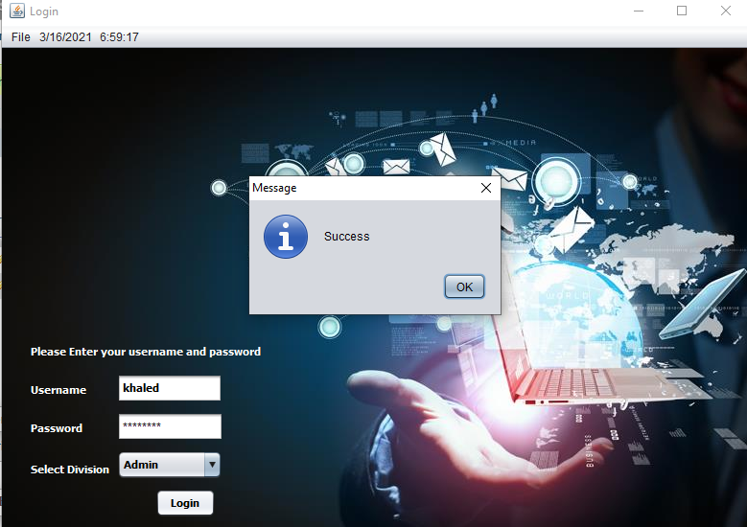
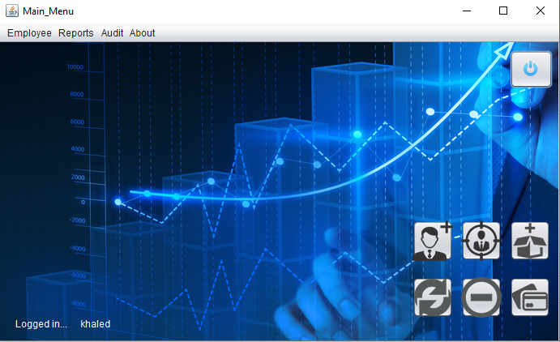
PROJECT DESCRIPTION
Login
After login Main

Slide 7
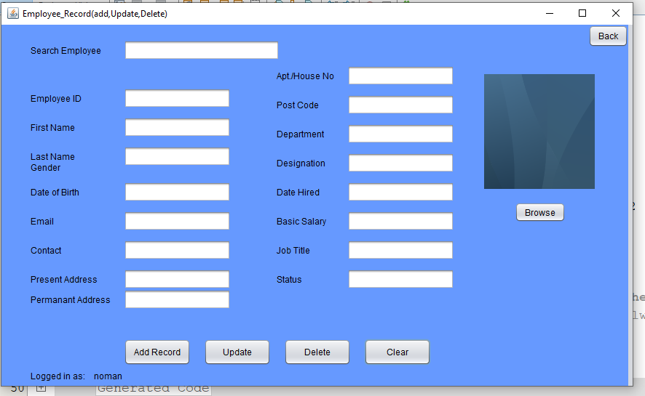
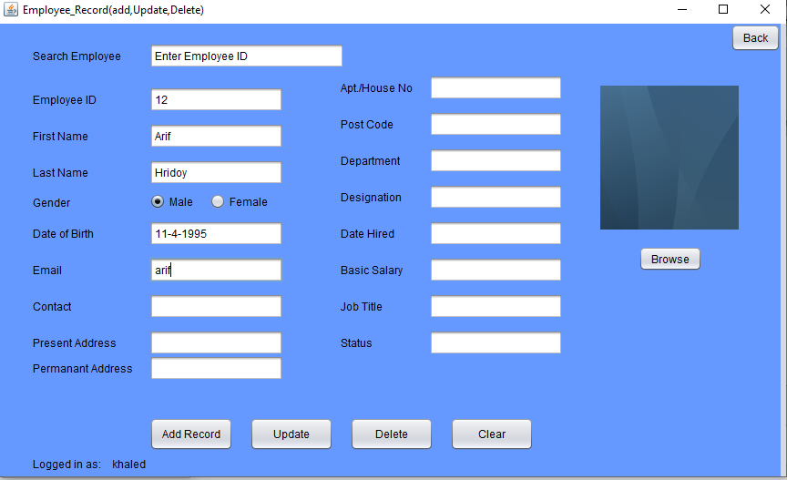
Add Employee
After Add Employee

Slide 8
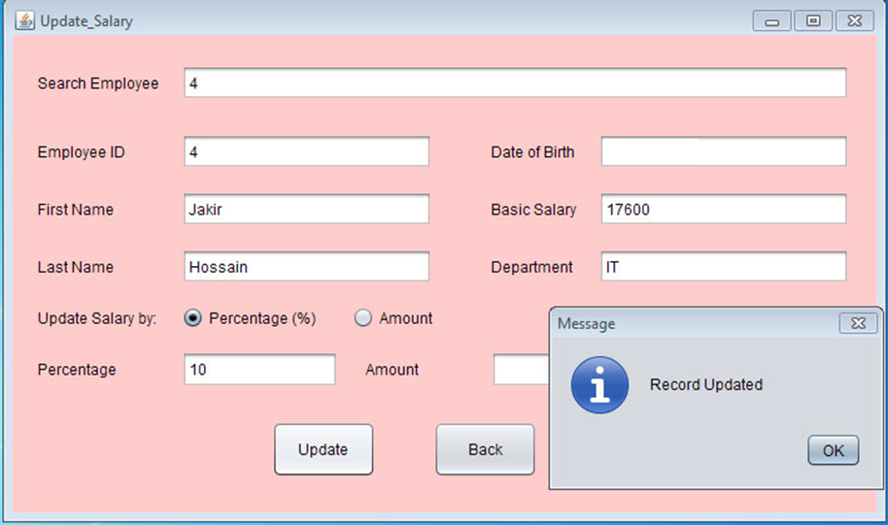
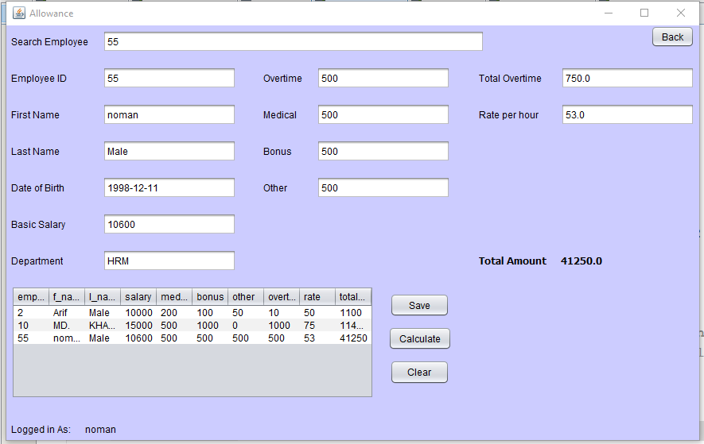
Update Salary
Allowance

Slide 9
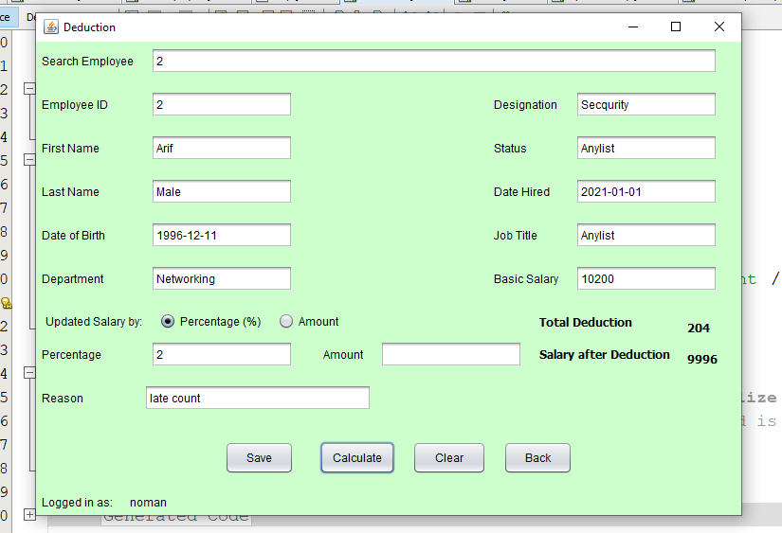
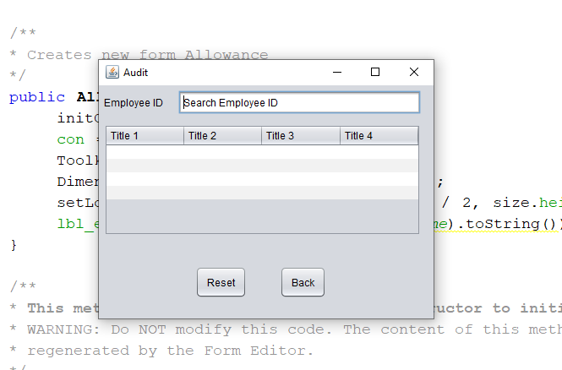
Deduction
Audit

Slide 10
CHOOSING A PAYROLL SYSTEM
It becomes difficult to find out the payroll system you specifically require. The criteria that help one to do so are as follows:
Security
Compatibility
Credibility
Flexibility

Slide 11
CONCULATION
The main aim of this project was to put whatever was learnt in java ,into practice. And the result obtained was a simple payroll calculator in addition to a new language learnt. Also it provide a better understanding of OOP.
This project helped in gaining confidence in writing the codes in java .

